Slide 1
Hostel Management Database
Presented by:
Sobhan Bose, XII A
Soham Chatterjee, XII A

Slide 2
About the Project
This project illustrates a prototype for how records can be managed through computer systems in organizations like college hostels.
This project makes use of the Python programming language and MySQL database system to store and retrieve records related to managing a hostel.
The data in this project includes aspects like student details, block and room details, mess details, staff details and transaction (fee payment, billing etc.) details.
For this project we have created a package named hostel_mgmt which contains numerous files that overall help us to add, edit, display or delete data from the main database.
All the SQL commands are run and maintained by Python and thus, there is no use of the Command Line Client in this project.

Slide 3
System Design
Table Structure

Slide 4
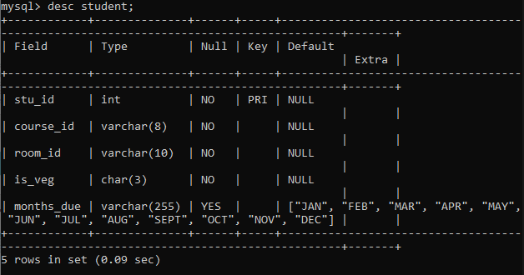
1. student

Slide 5
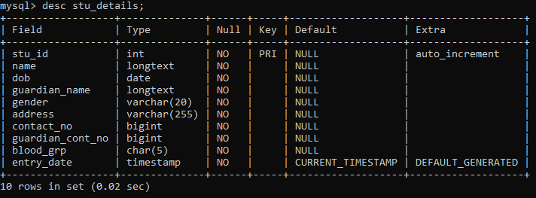
2. stu_details

Slide 6
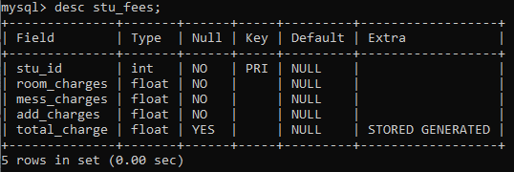
3. stu_fees

Slide 7
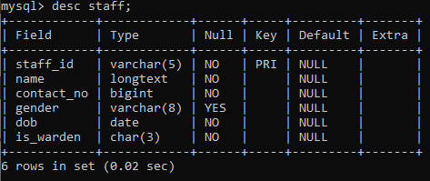
4. staff

Slide 8
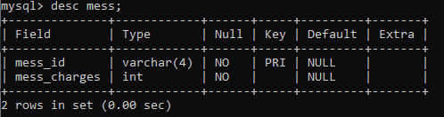
5. mess

Slide 9
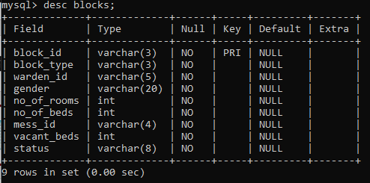
6. blocks

Slide 10
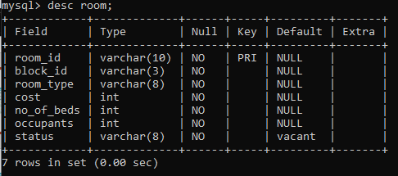
7. room

Slide 11
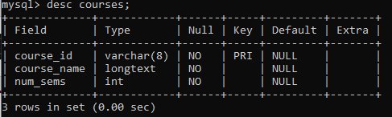
8. courses

Slide 12
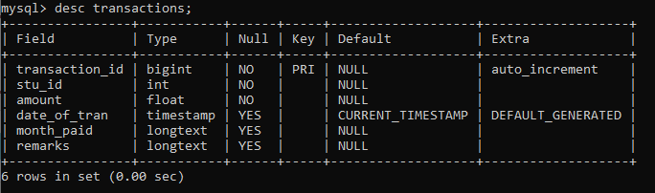
9. transactions

Slide 13
System Design
Data Flow Diagrams

Slide 14
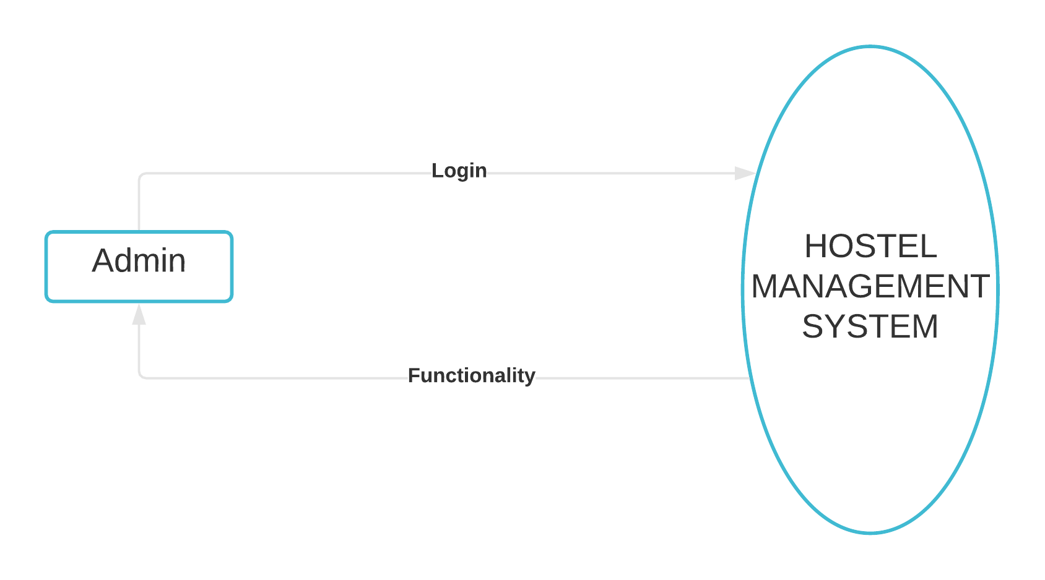
Level 0

Slide 15
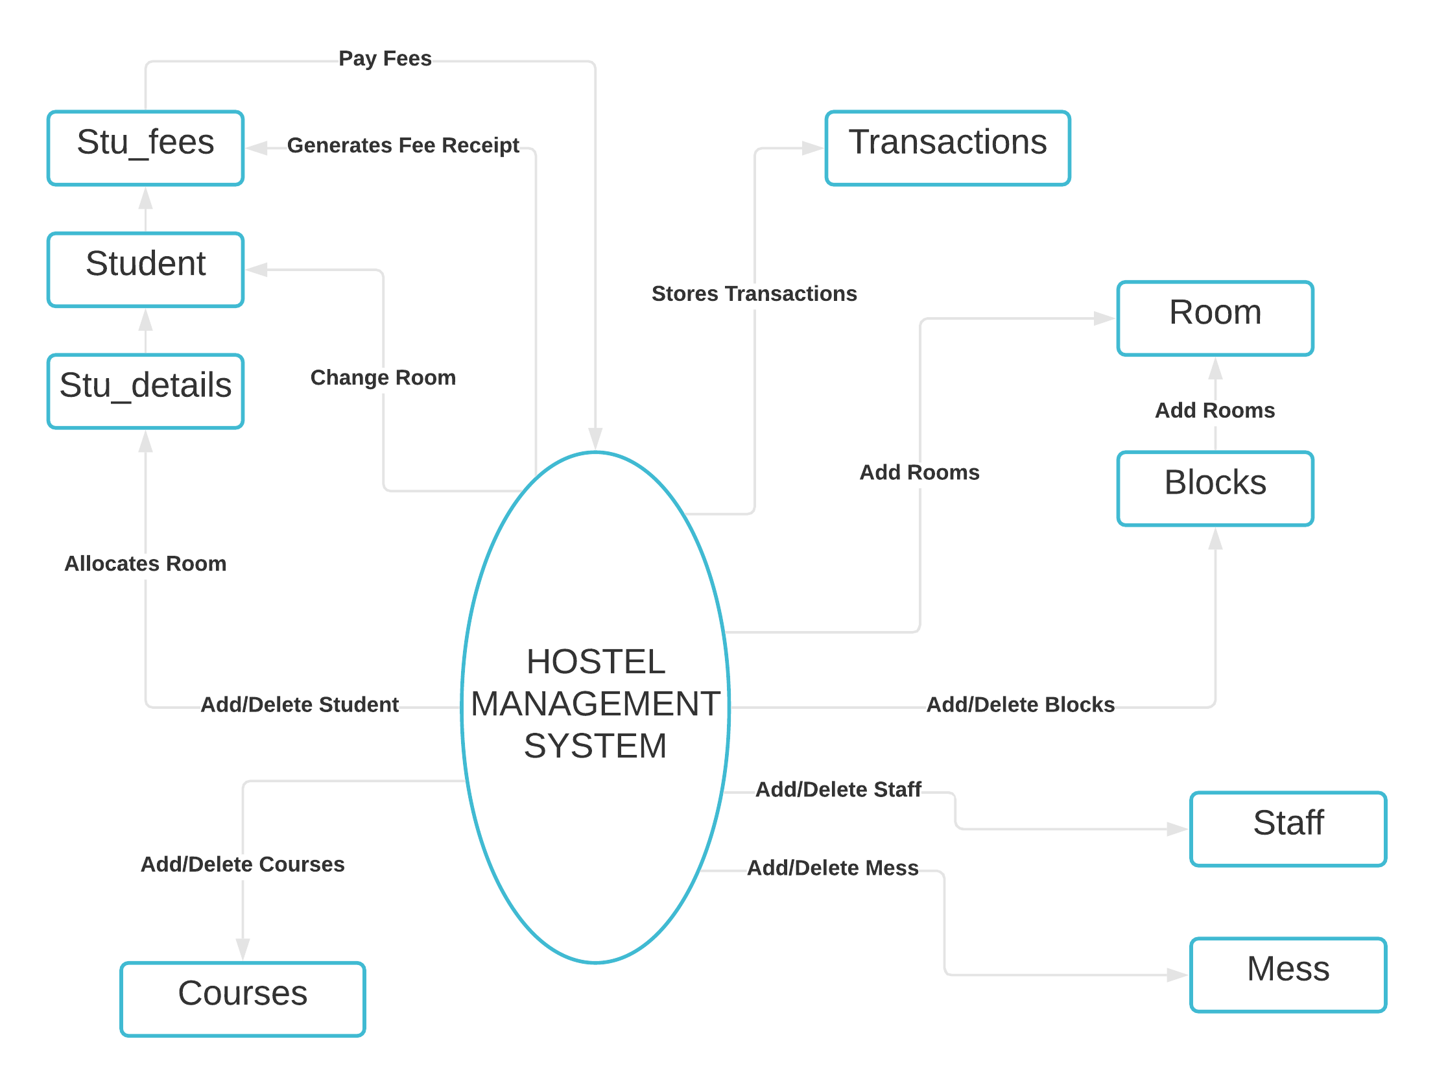
Level 1

Slide 16
Module Description Module Name: hostel_mgmt
File name | Description
__init__.py | Initializes the basic structure of the GUI along with the dimensions and placing
auth.py | Creates the initial login window for admin authentication
design.py | Creates the skeletal design of the GUI viz. the frames
left_frame.py | Creates the frontend design of the left frame
center_frame.py | Creates the frontend design of the center frame
right_frame.py | Creates the frontend design of the right frame

Slide 17
Module Description Module Name: hostel_mgmt
File name | Description
left_frame_func.py | Contains backend functions for buttons in left frame
right_frame_func.py | Contains backend functions for buttons in right frame
models.py | Contains backend functions for database queries to add, edit or delete data
support_queries.py | Contains backend functions for database queries to retrieve necessary data according to needs in right frame buttons
gen_pdf.py | Generates different PDFs as per commands received from the main GUI window
gen_details_pdf.py | Generates the PDF for the details of hostel data such as student details, block details, room details etc.

Slide 18
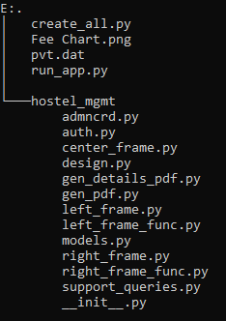
Directory Structure

Slide 19
Scope of the Project
The key highlights of the project are mentioned below:
This project would help in maintaining bulky databases of hostels without the fear of loss of data. It would solve problems like data redundancy, duplicity and many other.
This project includes authentication of the administrator with an user ID and password. The password is stored in a DAT file after undergoing a SHA256 encryption. So, if anyone manages to open the DAT file, then also he/she would be unable to see the password.
This project contains features such as adding details to database, editing any valid detail from the database, deleting any record from the database with proper authentication to prevent unauthorized access or unwanted errors, paying the hostel fees and even generating separate fee receipts for each student.
This project holds many areas that can be improved to make it a better alternative to manually managed database systems. For example, as of now, one can only pay the bill of a student in a chronological order of months in a year. But this project can be improved in a way such that one can pay the fees only of a particular month according to his/her desire.

Slide 20
Utility of the project
This project can be used as a software to maintain bulky databases in hostels of educational institutions where it becomes nearly impossible to manually take care of the huge volumes of data.
As this project is completely interface based, so, a person with absolutely no knowledge of computer programming languages can also get the most out of it.

Slide 21
Thank You!

